Slide 1
How to build a Blockchain and why you should (not)
Guest Lecture Advanced Data Architectures
22-04-2022
Stefan Driessen
Notes:
I am Stefan, PhD Candidate, colleague of Indika, I did research on smart contract testing and now data markets. I like blockchain
- Talk about technical and fundamental properties of blockchains. Talk about link to real projects. Architectural implications.
------ SWITCH -----

Slide 2
Before we begin
Who here has ever bought cryptocurrency?
Who here can give me a definition of blockchain technology?

Slide 3
My Definition
Blockchain is Decentralized, Distributed Ledger Technology (DDLT)
Notes:
Sometimes also called DLT

Slide 4
Outline
What do these properties really mean?
Why do we want these properties? (and why shouldn’t we want them?)
How do we ensure these properties?
When do we want to use Blockchain?
Notes:
I don’t know if we will fill two full hours, there will be time for questions, but my goal is to at least answer these questions.
We’ll start with what and why!

Slide 5
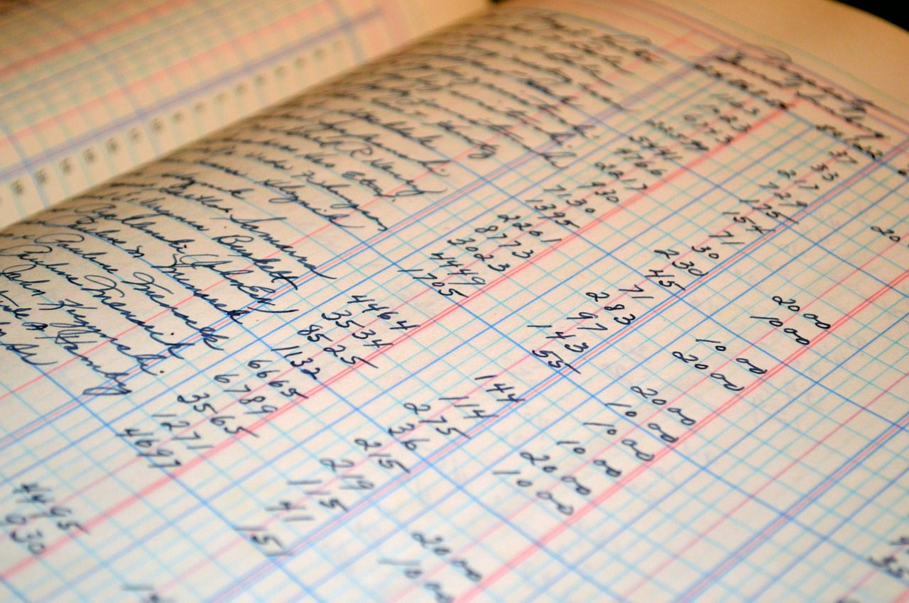
DDLT: Ledger
Ordered list of mutations of balances.
From, To, Amount, Value after transaction, Description, etc.
Let’s look at a Bitcoin Transaction
Blocks are ordered sets of transactions → Blockchain
A blockchain as a database.
Source: Investopedia
Notes:
In Dutch this is called a “kasboek”.
We can group together transactions in blocks and add many transactions at the same time.
Since they are ordered, we can call them a chain.
And this can be any kind of data!

Slide 6
DDLT: Distributed
What does it mean?
All the data in the ledger/blockchain is stored in multiple locations.
Why would we do this?
Transparency
Redundancy (immutability)
Easily accessible
Why doesn’t everyone do this?
All of the above!
High(er) cost
Necessary communication delay
Notes:
Every person who contributes to the blockchain network, stores all the information / the entire blockchain.
You can try sharding, but generally the data storage is redundant.
You sometimes hear cryptocurrency is good for criminals and there is some argument to be made for that, but every transaction is also transparent.

Slide 7
DDLT: Decentralized
What does it mean?
No one entity is in charge of the ledger
Adding new data and removing / changing old data
We need consensus
Why?
Autonomous – Example
Trust(less) / Immutable – No one can change your data.
Democratic
Why not?
Hard to correct mistakes
Necessary Delay
Notes:
- Trustless: As long as the system works, no one can take your money, change your agreements / fine print, no one can change your code, etc.

Slide 8
The How
Cryptographic encryption for accounts
(Even though everything public, only I can use my account)
The consensus protocol
(How do we ensure that everyone’s copy is the same?)
Notes:
These are two pillars that every blockchain has and if you want to evaluate if a blockchain / cryptocurrency is good. You should ensure these two elements are good.
And we’re not going to talk too much about cryptography. It is really important, but it has the same fundamentals as e.g., your email. So it uses public keys and private keys and signing of transactions to prove you are entitled to send transactions
I put consensus protocol in fancy animation, because it is really important. It really is the core of any blockchain. If you understand the consensus protocol, you understand how a blockchain works and how one blockchain might differ from the other.

Slide 9
The challenges of consensus: A thought experiment
We are starting the new JADS blockchain with JADS-coin.
You can earn JADS-coin by attending lectures.
You can use JADS-coin to buy beer with Patterns.
You can trade JADS-coin with your peers.
We all keep a ledger of every transaction of JADS-coin!
We can instantly broadcast our transactions to another (e.g. groupchat).
What happens when a transaction is missing from someone’s ledger?

Slide 10
Why everything needs to be in everyone’s ledger
If a transaction to you is missing
You can’t spend your JADS-coin with that person.
If a transaction from you is missing
You can re-spend your JADS coin with that person (doublespending).

Slide 11
What about consensus
Why is it hard to achieve consensus?
We don’t know each other, we don’t trust each other.
We check each other, to keep each other honest.
Naïve solution: For every new block, we vote: if we can convince a majority of the nodes, we are happy.
Notes:
This might work in the digital world, but even in the digital world. People might spam or it might go too fast.

Slide 12
Solution: Proof of Something
Adding a block costs time & money!
Checking a block is quick & free.
We all follow the longest chain (i.e. the one with the most blocks). So you want to add blocks to the longest chain only.
Because you invest time & money, you are rewarded: coinbase + fees if other people verify your block.
Does this work?
Notes:
Yes!
Because it costs time, it is difficult to spam messages.
Because it costs money, it is expensive to lie.
Because we follow the longest chain, you have to start again when a new block is shared.
Because you get rewarded you are willing to put in the effort.

Slide 13
Proof of Work
First one, all major blockchains use this.
The real-world investment is computational power.
Uses a hash function: Which is a function that takes a long number as input and maps it to a shorter output number.
The output has to be small (this is what takes up the computational power)

Slide 14
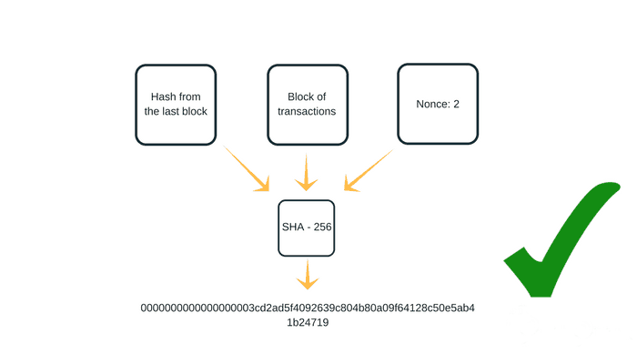
Proof of Work: Calculation
Source: Async Labs
Notes:
- So in order to present a valid block the miner has to share it alongside a block hash. We use a hashing algorithm called SHA256 and it takes as inputs:
And if you have these inputs it’s easy to validate that the output is correct.
The challenge is finding a good nonce.

Slide 15
Proof of Work: continued
Two properties of hashes that make this work:
Hash function is non-surjective (i.e. it’s easy to check a solution, but hard to find one).
Hash function is random (i.e. the most efficient method to get a low hash value is brute-force.
Disadvantages?
Super (electricity) expensive
Bad for decentralization: mining pools.
Notes:
And there’s something else important happening here, if we go back we can see why immutable.

Slide 16
Proof of Work: Immutability
Source: Async Labs
Notes:
And this is also how we get to immutability, looking back at this picture. Who can tell me which aspect of this makes it hard (almost impossible) to change data that is already on the blockchain?

Slide 17
Proof of Work: Immutability
Notes:
Because let’s assume want to change some block in the past. So we are currently at block N and we want to change some information from three blocks ago. Beer

Slide 18
Proof of Work: Immutability
Notes:
Obviously, if we change the context of block N-3, it changes the hash of that block. In fact, we have to mine it again because we have to find a new nonce so that the value is low enough.

Slide 19
Proof of Work: Immutability
Notes:
But remember, we just talked about this. The subsequent hash, depends on the previous hash. So if we change the hash value of block N-3, it changes the hash-value of block N-2. And we have to remine block N-2.

Slide 20
Proof of Work: Immutability
Notes:
Etc

Slide 21
Proof of Work: Immutability
Notes:
Etc. So changing something in a past block means, having to remine all the blocks that come after that. Because the miners have agreed to follow the longest chain, it is incredibly hard to do this.

Slide 22
Proof-of-Work: Consequences
Changing something in one block, means having to re-mine all subsequent blocks.
This is practically impossible, unless?
If you can mine faster than all other miners combined, you can change the past in a blockchain
This is known as a 51% attack
Notes:
And this has been done, there has been at least one live stream where someone took a small cryptocurrency and got 51% of the hashing power in the pool and created a fork.

Slide 23
Proof of Stake
You lock cryptocurrency, your chance to add a block is proportional to your stake compared to total stake.
The “real world” investment is cryptocurrency from the chain. Is this a real-world investment?
Every time a block is mined the miners randomly assign a next person or group of persons.
Solves the scalability and energy problems!
Not really being used in practice yet.

Slide 24
Proof of Stake: Example
Notes:
So let’s briefly look at how this goes.
Imagine, we have a chain of blocks and we want to be involved in adding a new block. Block N+1

Slide 25
Proof of Stake: Example
Notes:
So this is us, we are a miner, trying to make money or contribute to the blockchain or whatever.

Slide 26
Proof of Stake: Example
Notes:
The first thing we do is lock some our coins. I.e. we stake them. This is done through a transaction, in a previous block and it means that we demonstrate that we are invested in the network. After all, if we add blocks in a wrongful or malicious manner, the network will lose value and thus our coins will lose value. And we cannot spend our coins, because we have locked them for a certain amount of time.

Slide 27
Proof of Stake: Example
Already staked: 7000 coins
Our share: 3000/(7000+300) = 30%
Notes:
Now let’s say we stake 3000 coins, for the sake of simplicity I will say that brings the total staked coins to 10 000, so our share is 30%. This means, we will have a 30% chance of being able to add new blocks, every time a new block is added.

Slide 28
Proof of Stake: Example
Already staked: 7000 coins
Our share: 3000/(7000+300) = 30%
Notes:
Because what happens is, part of the creation process of block N, is that there is a lottery which assigns the next miner based on their share in the total stake. Of courses, if we get picked and create the next block, everyone still checks whether the block is valid. And you can see this is much more efficient, than proof-of-work. But it’s also scary because it hasn’t been tested as extensively yet.

Slide 29
Forks
Notes:
Forks are a result of failure to reach consensus. One group follows one chain, one group follows another.

Slide 30
Forks
Why do forks happen?
Two miners create a new block at (roughly) the same time
Some miners decide to follow a different protocol: e.g., bitcoin cash
Some miners decide they want to change the “immutable” ledger: e.g., the DAO-attack
Notes:
This is why you should always wait 6 blocks

Slide 31
Smart Contracts
Remember: any data can be on the blockchain!
We can put code on the blockchain.
Only need two things:
Execution environment that comes with the blockchain
Miners keep track of code state in addition to transactions.

Slide 32
Smart Contracts
Why do we want smart contracts?
Decentralized
Distributed
Transparency
Easy Access
Democratic
Redundancy
Cost reduction
Immutable
Trust(less)
Autonomous
Notes:
Now we have covered the what, why and how. With smart contracts, we can go to the when.
All those benefits, we had when talking about DDLT

Slide 33

Application: Non Fungible Tokens
Smart contract to keep track of who claims (digital) ownership of what.
Advantages?
Disadvantages?
No legal recognition!
Hard to enforce ownership
©rv

Slide 34
Application: Data Market
Data Providers and Data Consumers exchange data.
The exchange is facilitated by a fully autonomous, smart-contract based data market.
Advantages?
Disadvantages?

Slide 35
Application Domains
Disclaimer: I cannot predict the future!
Blockchain makes sense when:
You benefit from Decentral, Distributed data architectures.
Multiple parties share the same infrastructure, but they don’t want to have to trust each other.
Agreements can be automated
The people involved understand the code / smart contracts
In general Blockchain technology can be used to eliminate the need for trusted third parties
Notes:
This is my personal opinion, but it is a motivated opinion.
Replacing “trustworthy” third parties
Supply chains
Marketplaces
Public and Private blockchains
Thoughts / Questions?

Slide 36
Master Thesis Proposal
Automate Data Product Monitoring
with Smart Contracts

Slide 37

Application Domains: Supply Chains
Notes:
Both of these are commercials, so they are way to romanticised, but they still have interesting points.
First of all note: the shipment data itself is not online. But the permission management and signing of documents is.
Why does this make sense?
Many different parties
They do not necessarily trust each other: i.e. port authorities should not trust all the ships coming in.
Still, they benefit from sharing data.
Blockchain makes it easy to demonstrate that the data you are being provided is real, and was added / edited at specific times. I can show that my shipment was checked by Chinese customs at a certain date and place.

Slide 38

Data Markets
Notes:
Super commercial
But if you think about Data Markets, it makes sense:
There are many parties: data buyers, data sellers, service providers, etc. etc.
These don’t necessarily trust each other.
The way in which data is transacted, governed, paid for, etc.
It makes sense to do this in a manner that is: transparent, automatable, autonomous, decentralized.
Again, we are not necessarily putting the data on blockchains, but the mechanisms (i.e., the code that we use to govern the interactions).

Slide 39
Thank you for listening
Notes:
Any questions?

